Slide 1
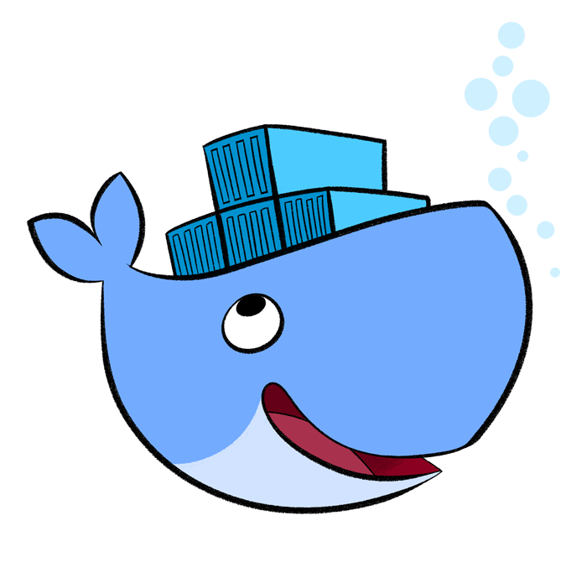
Getting Started: Windows Server Containers
Flynn Bundy, Coolblue
Notes:
Open:
DockerHub
gitHub
Azure portal

Slide 2
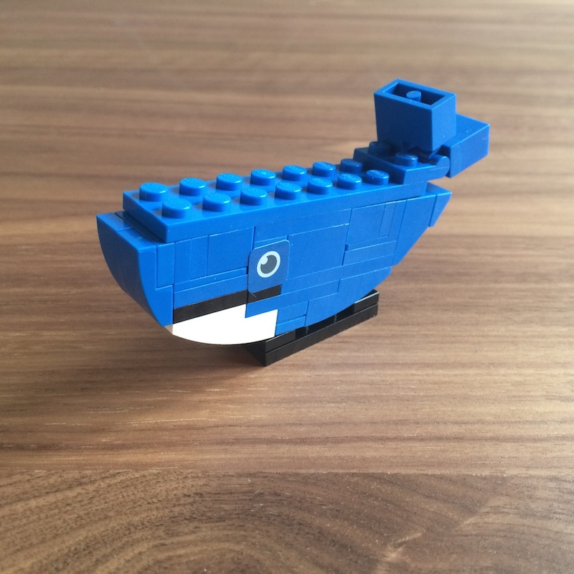
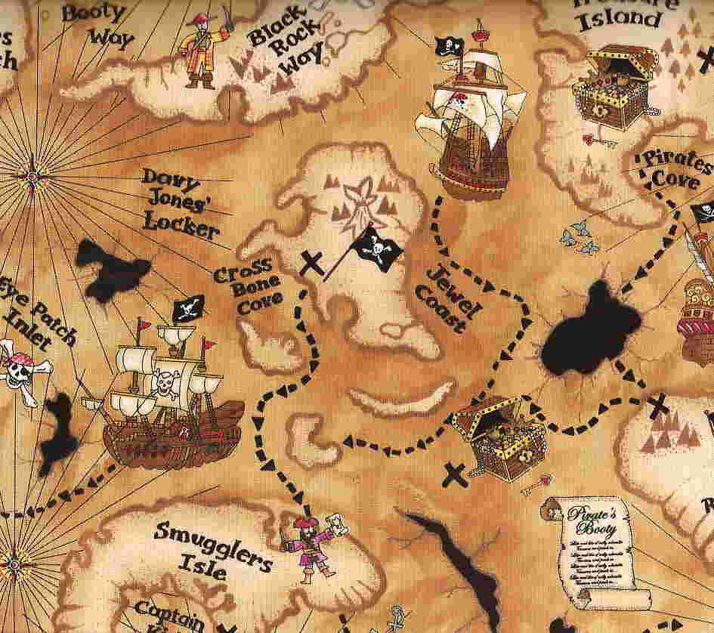

Agenda
What are Containers?
Working with Docker
Building and Deployment

Slide 3
What is a Container?
Containers wrap a piece of software in a complete filesystem that contains everything needed to run.
Notes:
JUST what we need and nothing more.
In the “born in the cloud era” we shouldn’t need to pay for things we don’t use.

Slide 4
What is a Container?
Ops
Dev
Notes:
Is one way of allowing the Bridge between development and operations
Developers can do local dev and push their image to a registry
Less focus on servers – more on applications

Slide 5
Notes:
Blogs / websites / media

Slide 6
Notes:
Reality: its new and it requires investment: design to fail

Slide 7

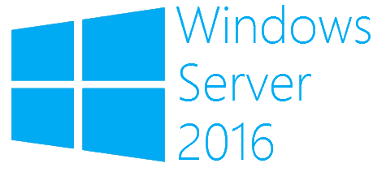
Types of Windows Containers
Hyper-V Containers
Windows Server Containers
Notes:
Isolation is the main difference
Hyper-v containers don’t share the same host level kernal
Windows servers share the NT kernal with the host

Slide 8
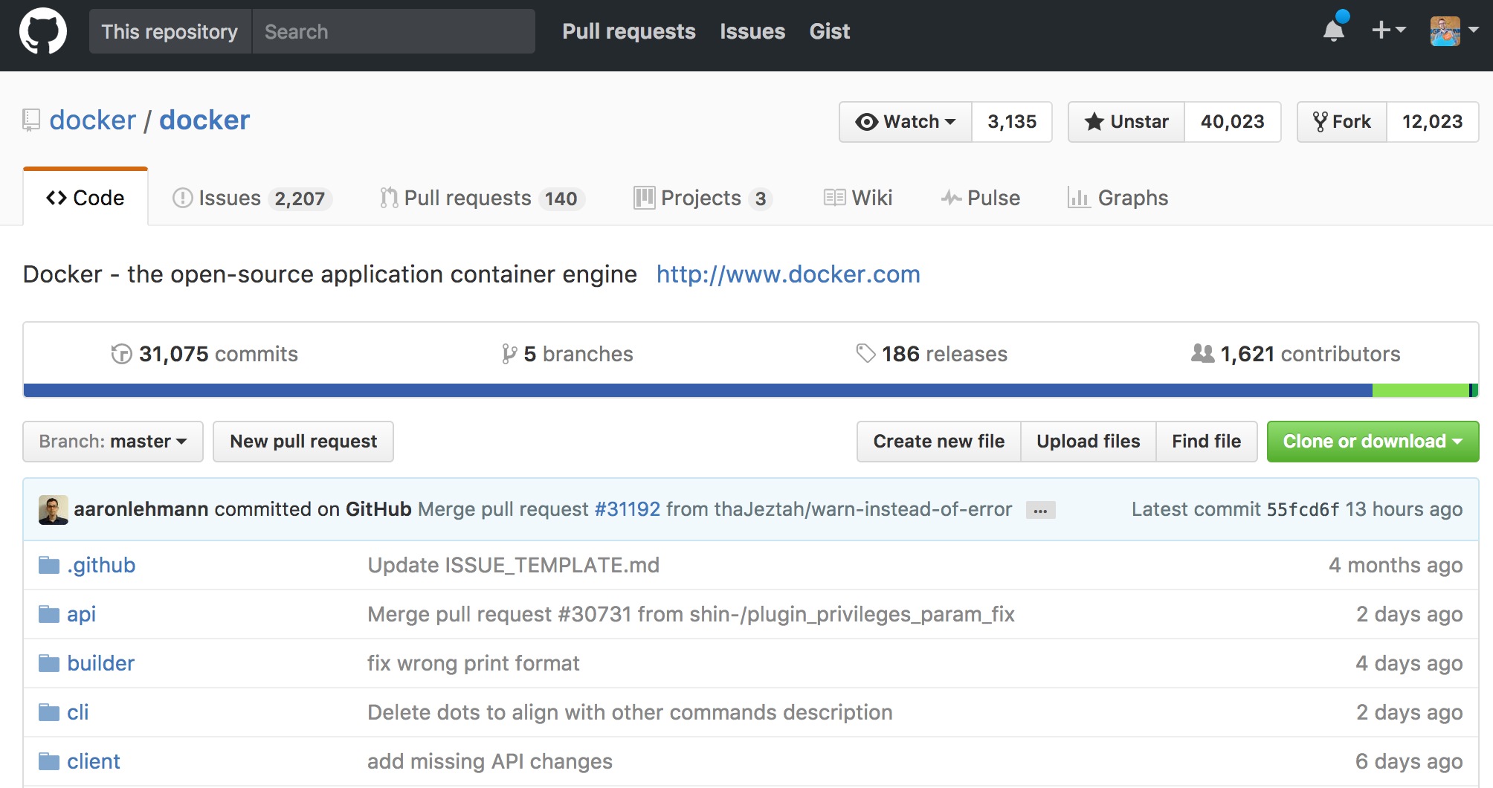

Docker
Notes:
Open source
Golang
Cross platform

Slide 9
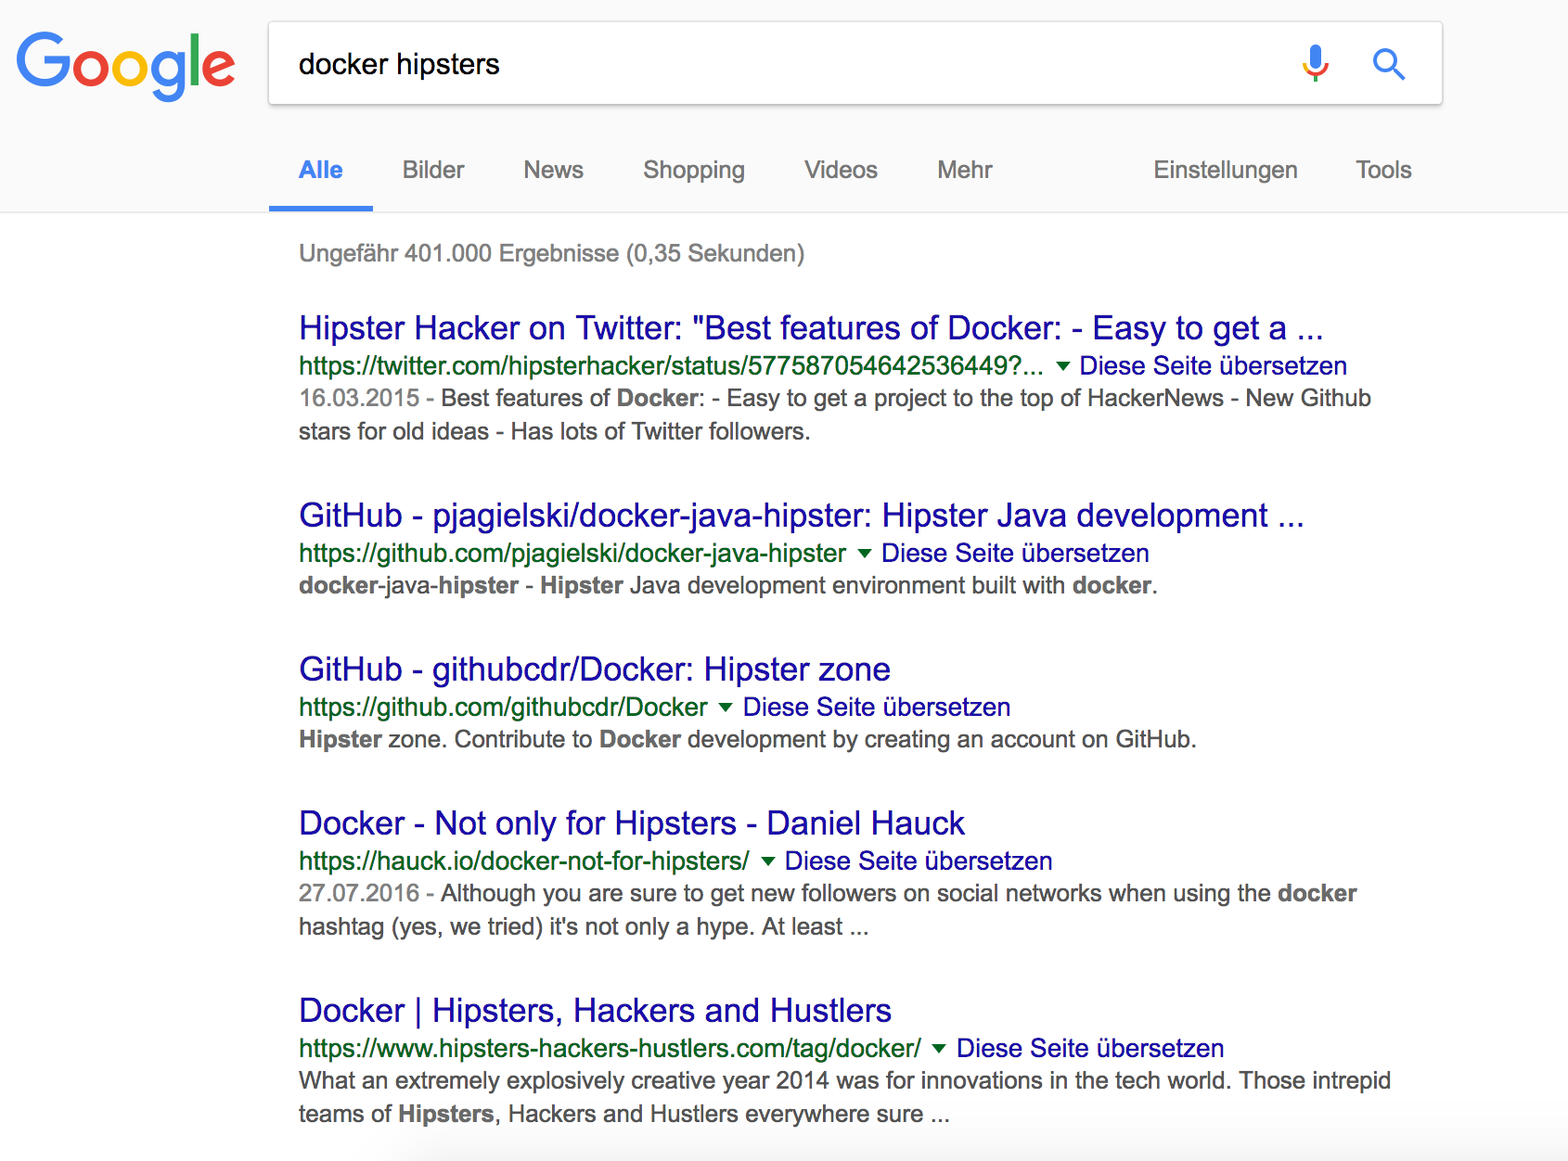
Docker
Notes:
May feel hipster-ish but its here to stay

Slide 10
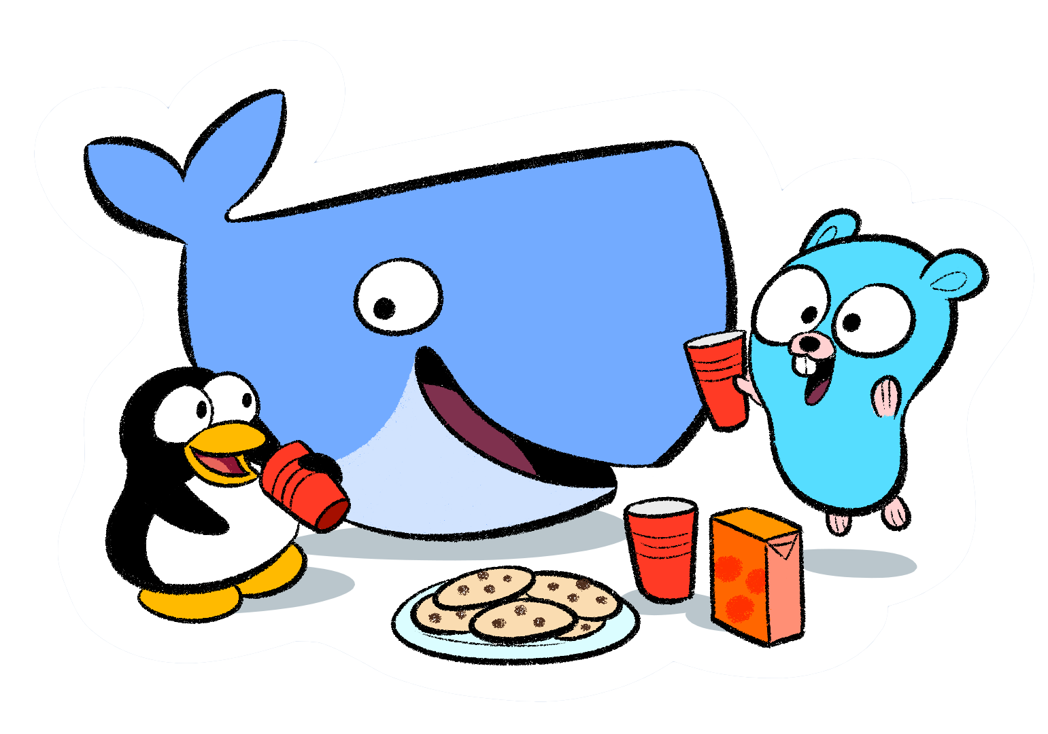
New Operating Model
Notes:
New operating model – forget what you know
Throw it out the window
New operating model for a specific born in the cloud type workload
Smaller, faster, scalable, just what you need

Slide 11
Born in the Cloud era
Please don’t run a Domain Controller on me!
Notes:
Not for traditional operational tasks
Domain controllers
Configuration management etc
1 process per container ONLY
Immutable infrastructure

Slide 12
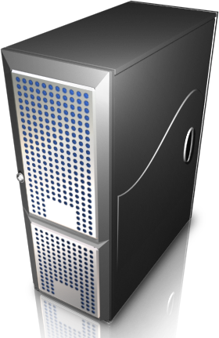
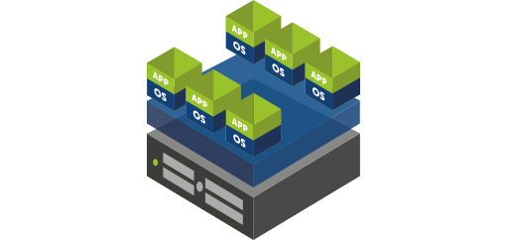
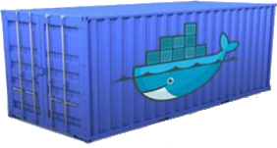
How did we get here?
Physical Servers
Virtual Machine
Containers
Virtual Machines
Notes:
Server for the masses
Enterprise Era
Datacenter Era
Cloud for the masses
Evolution / how we got to this point

Slide 13
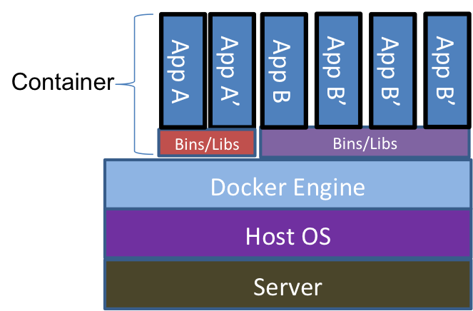
What does a Container look like?
Virtual Machines
Notes:
Server which runs a OS like normal. The OS runs the Docker engine we build images on that host and run our containers
The binaries and libraries are available to that specific namespace

Slide 14
Issues Containers can help solve.
Windows Updates
Unrequired Processes
User Management
Image size
Unrequired Features
Clustering
Configuration Drift
Storage Issues
Configuration Management
Start-up Times
Large Management Overhead
Virtual Machines

Slide 15



Container Management
Notes:
Orchestration and management container systems

Slide 16
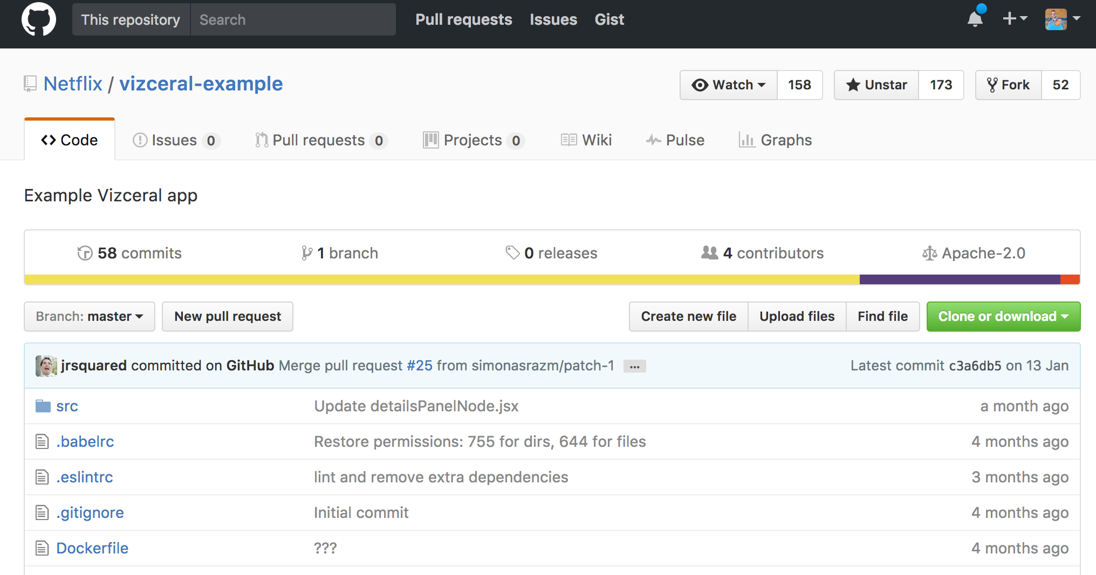

Docker – making things easy!
Notes:
Abstracting complexity from software development and collaboration

Slide 17
Demonstration!
Notes:
https://github.com/Netflix/vizceral-example

Slide 18
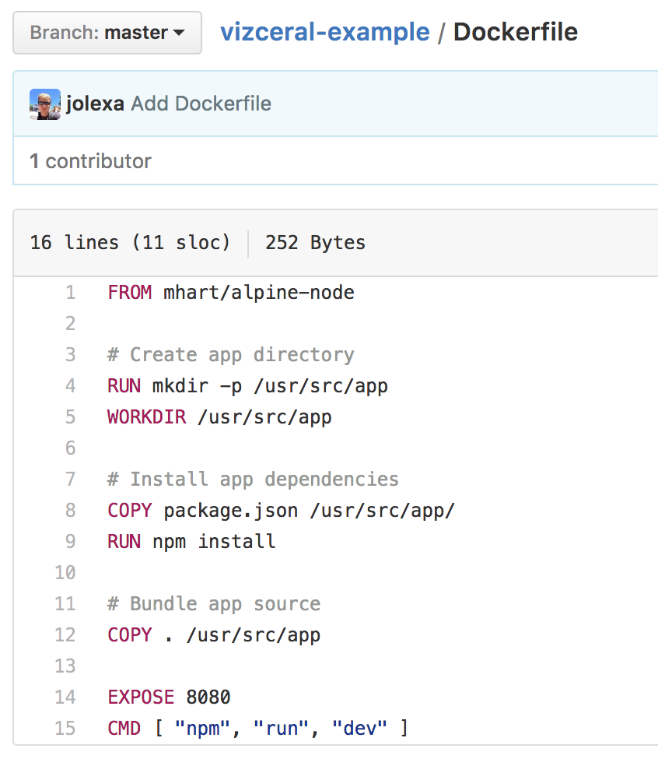
Everything is a Layer
Start Point
Run Commands
Copy Content In
Main Command

Slide 19

Layers!
Notes:
Layers + caching + images

Slide 20
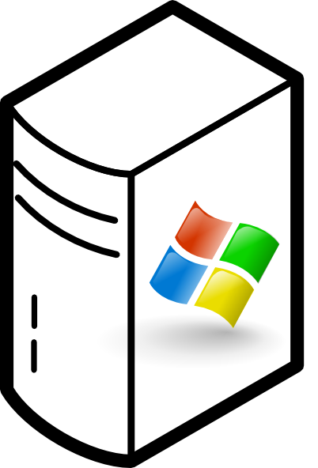

Notes:
Lets say I have these three apps

Slide 21
Notes:
Container Linking
When we link the container name gets inserted into the linked containers host file
Only the single port is exposed otherwise its impossible to communicate with anything inside a docker network

Slide 22
Notes:
Clustering in available natively with Docker via Swarm mode
In swarm you create a definition of your service in YAML. The Swarm engine is then responsible for evenly distribution your application over multiple hosts to ensure availability and elasticity.
This is what is used for production deployments
This is what most managed services like ACS, ECS will abstract.

Slide 23
Demonstration!
Notes:
Remember –e for apikey

Slide 24
Summary
Pick a simple application (or make your own) and run it in a Container locally.
Learn about Container Orchestration systems such as AWS ECS, Kubernetes, Docker Swarm and Azure Container Service.
Take it upon yourself to learn more about applications as opposed to what they are running on.
Transformational Change (some won’t make it)

Slide 25
Questions?

Slide 26





About_Author
bundyfx
@bundyfx
flynnbundy.com
careersatcoolblue.com

Slide 27
Next Steps...
Now: 15 min break
Grab a coffee
Stay here to enjoy next presentation
Change track and switch to another room
Ask me questions or meet me in a breakout session room afterwards

